Slide 1

Seasonal Agriculture Performance Analysis
LIKHITHA K

Slide 2

PROBLEM STATEMENT
The problem is to analyze the given agricultural dataset and investigate seasonal differences in agricultural performance by identifying meaningful patterns, trends, relationships and variations within the available data.

Slide 3
Project Description Agricultural activities are shaped by seasonal variation — changes in rainfall, temperature, humidity, soil condition and resource availability across the **Kharif**, **Rabi** and **Zaid** cropping seasons. This variation affects yield, production, resource consumption and, ultimately, farm profitability.

Slide 4

WHO ARE THE END USERS?
Farmers — deciding which crops to grow in which season, and how to allocate resources (water, fertilizer)
Agricultural extension officers / advisors — giving season-specific guidance to farmers in their region
State agriculture departments / policymakers — planning subsidies, irrigation infrastructure, or crop insurance around seasonal risk (e.g. Zaid's high loss rate)
Agri-input companies (fertilizer, seed, irrigation equipment) — targeting products/timing based on seasonal demand and usage patterns
Banks / agricultural lenders & crop insurers — assessing seasonal risk when offering loans or insurance
Agribusinesses / commodity buyers — planning procurement around expected seasonal yield and price patterns
Researchers / agricultural universities — using the patterns as a starting point for deeper agronomic studies

Slide 5

Technology Used
Technologies Used
Programming Language
Python
Development Environment
Jupyter Notebook
Libraries & Tools
Pandas – Data cleaning, manipulation, and analysis
NumPy – Numerical computations
Matplotlib – Data visualization
Seaborn – Statistical analysis and visualization
Data Source
CSV Dataset
Problem Statement provided as PDF

Slide 6
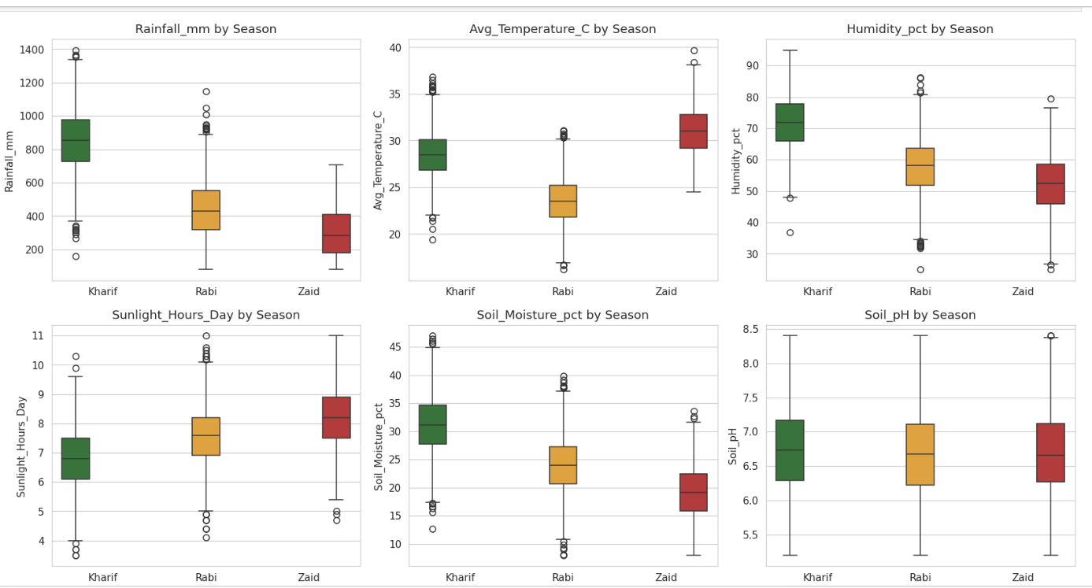
RESULTS
Demo Link

Slide 7
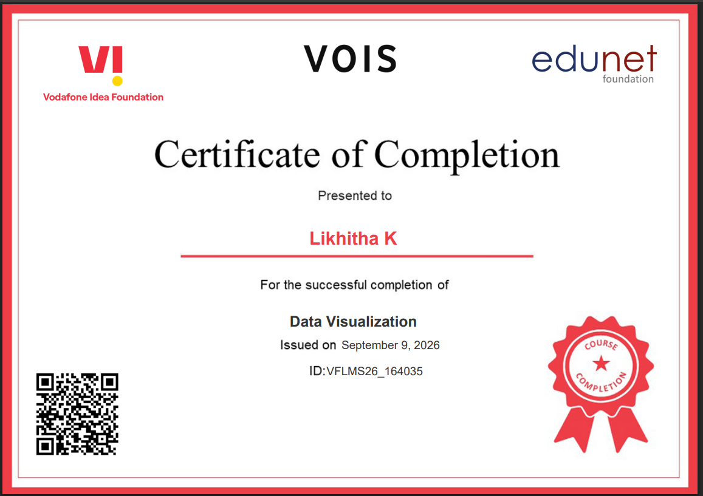
Data Visualization Certification

Slide 8
Thank you
Thank you for your time and attention.
.
.

